Slide 1
ICRER
2020
CONFERENCE REPORT
November 19-21, 2020

Slide 3
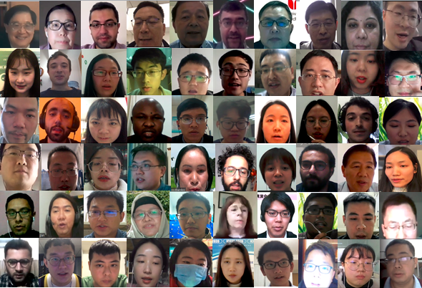
GROUP PHOTO

Slide 20
Thank you
ICRER 2021 will be held in Xiamen University of Technology, China during 2-4th December, 2021
We also would like to invite you to attend ICRER 2021
Looking forward to meeting you next year!

